Slide 1
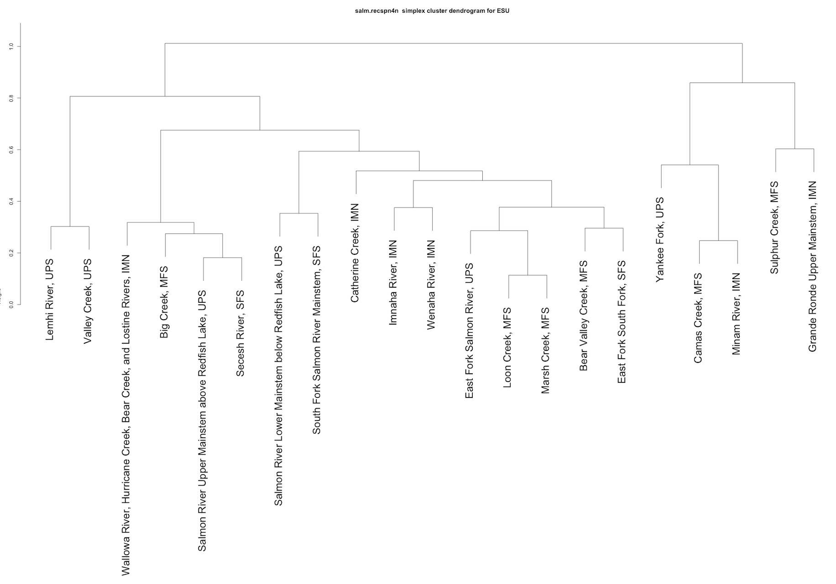
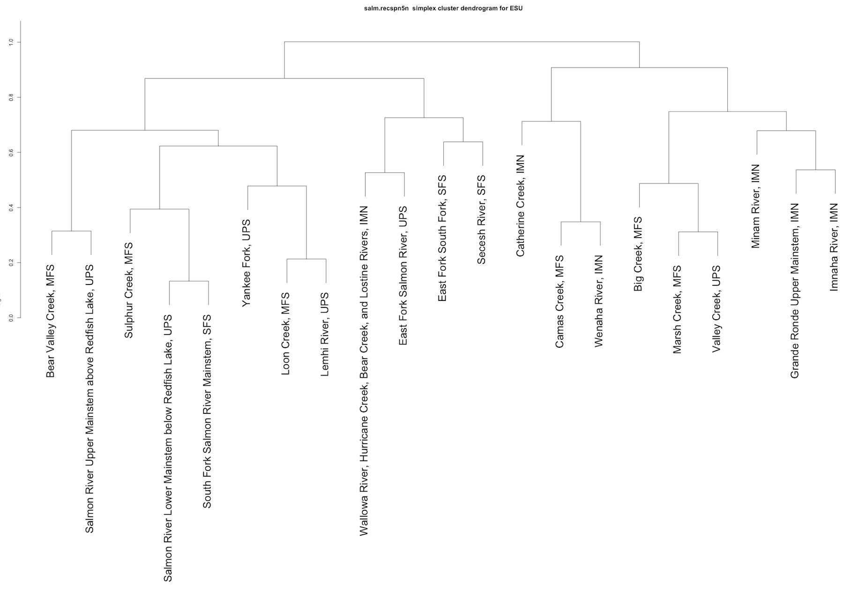
4-year old recruits per spawner
ESU
5-year old recruits per spawner
D_1
D_1
0000
D_2
D_3
D_2
D_3
D_4
D_4
D_5
D_5

Slide 2
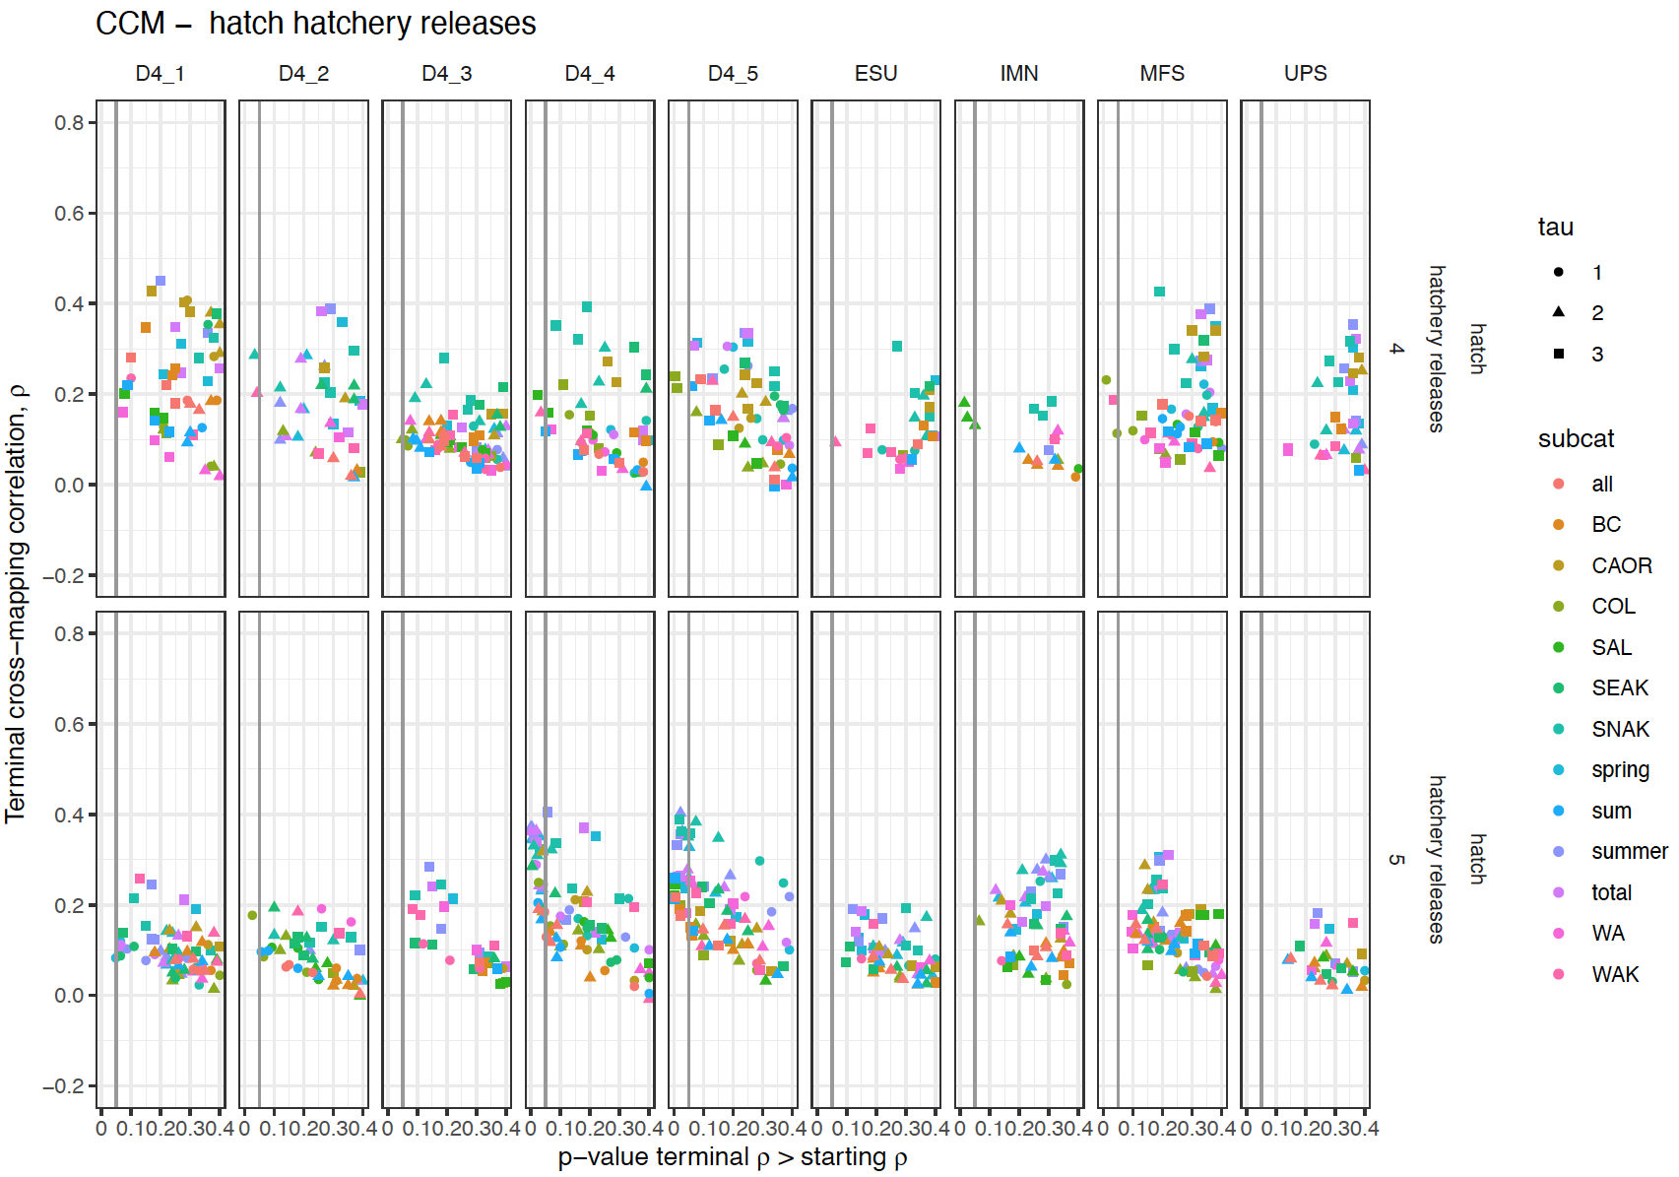
These are the CCM results (for hatchery releases) with 4yo recruits per spawner data on the top row and 5yo on the bottom. Each column is a different grouping of stocks. ESU include all stocks, IMN, MFS and UPS are the different MPGs. D4_1 through D4_5 are the groupings from the hierarchical analysis on slide 1. The terminal rho of the CCM is plotted against it’s p-value of the test that it is higher than the minimum library rho.
Note that many hatchery releases (particularly the SNAK) are only significantly causally related to the the hierarchical groupings and with a higher rho.

Slide 3
Middle Fork Salmon
4 year old recruits per spawner
MFS_1
MFS_1
Loon Creek and Marsh creek are very similar for rec4 but not for rec5.
5 year old recruits per spawner
MFS_2
MFS_2

Slide 4
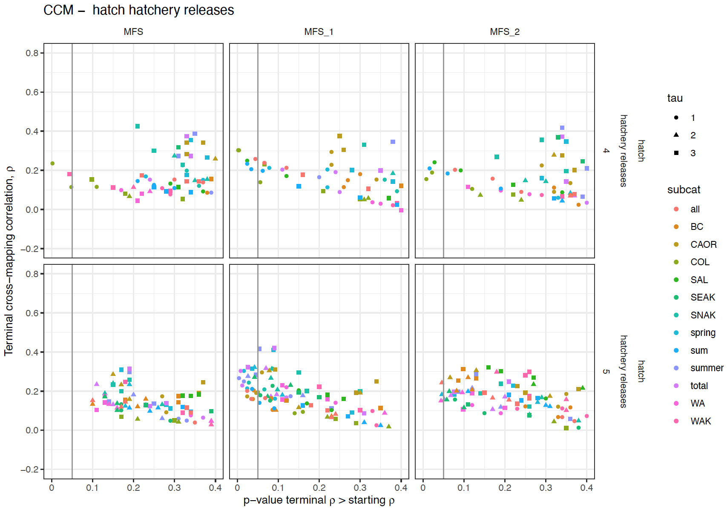
For Rec4, the smaller clusters show additional causal variables
For 5-year old recruits the effects are significant in the smaller clusters and with a higher rho.

Slide 5
Upper Salmon
UPS_1
UPS_1
4 year old recruits per spawner
The Salmon River above and below Redfish Lake are very similar for rec5 but not for rec4.
UPS_2
UPS_2
5 year old recruits per spawner
UPS_3

Slide 6
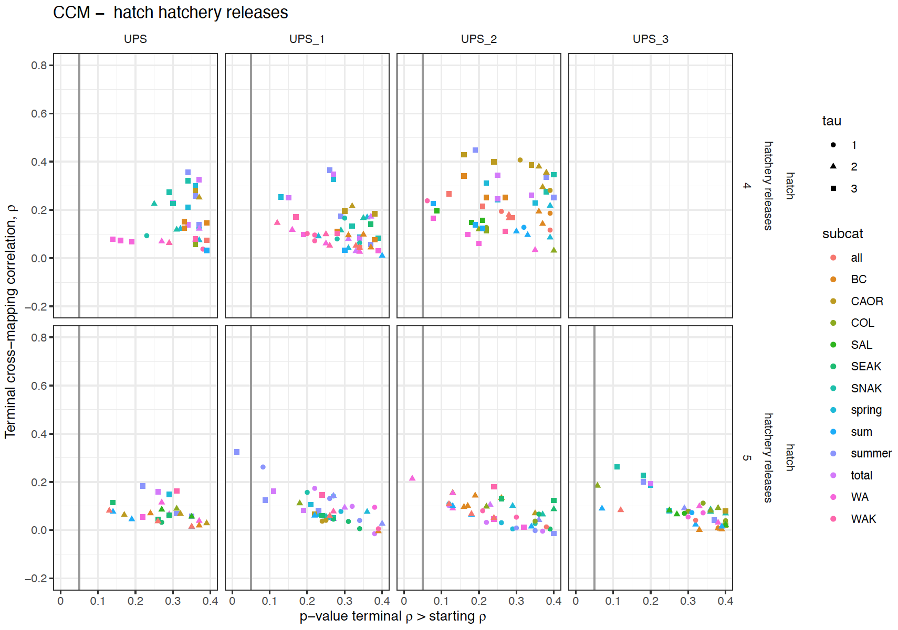
Different variables are causal for rec5 in the smaller USP clusters

Slide 7
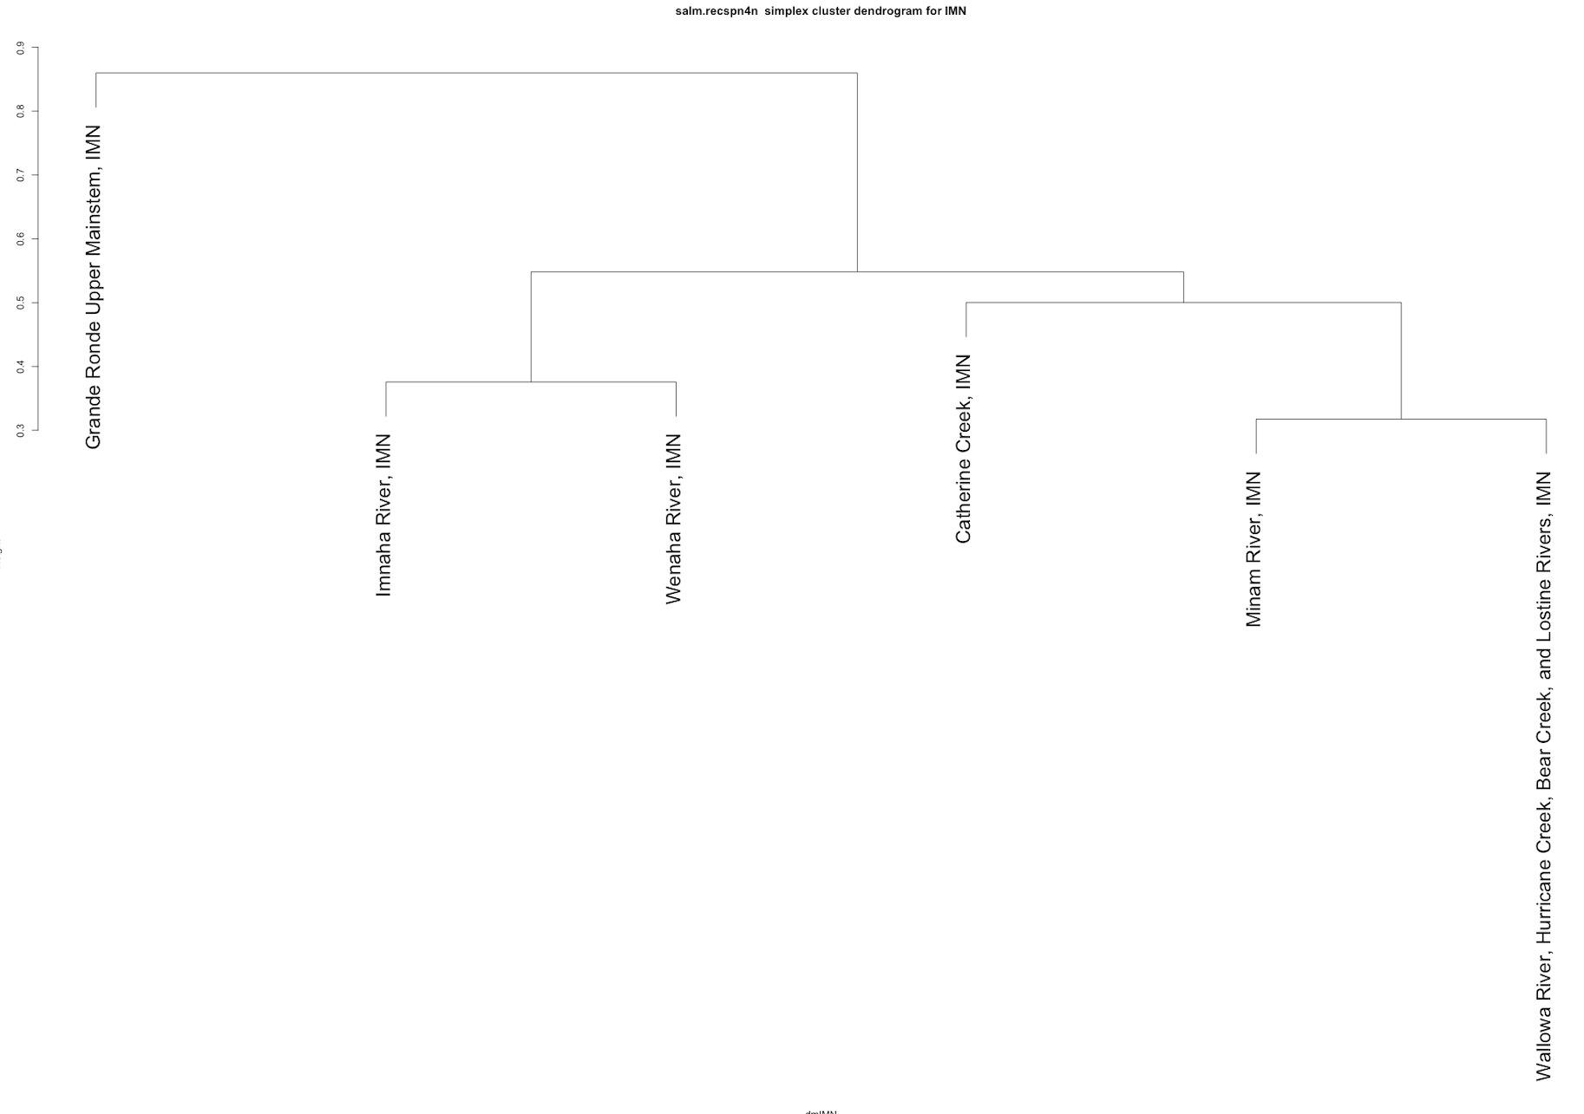
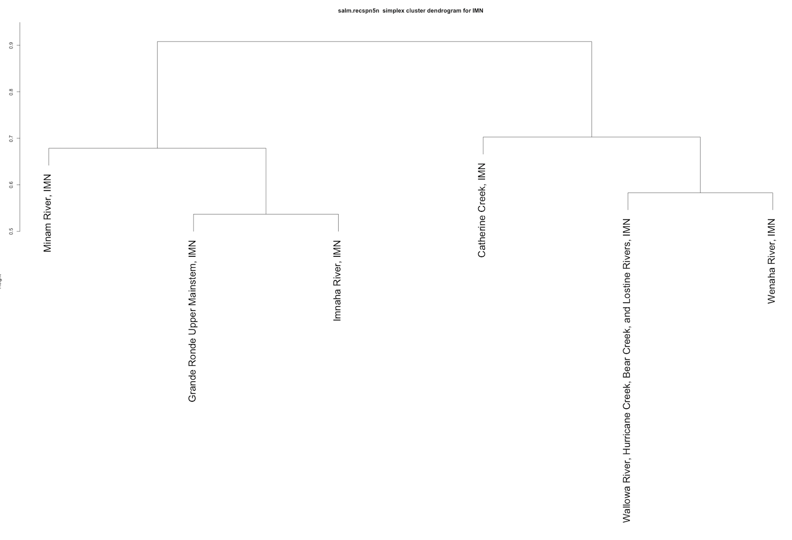
4 year old recruits per spawner
Imnaha
5 year old recruits per spawner
IMN_1
IMN_1
IMN_2
IMN_2
Lostine River and Wallowa contain the same data. Need to rerun this analysis without Lostine R. Explains why they predict each other so well for both rec4 and rec5.

Slide 8
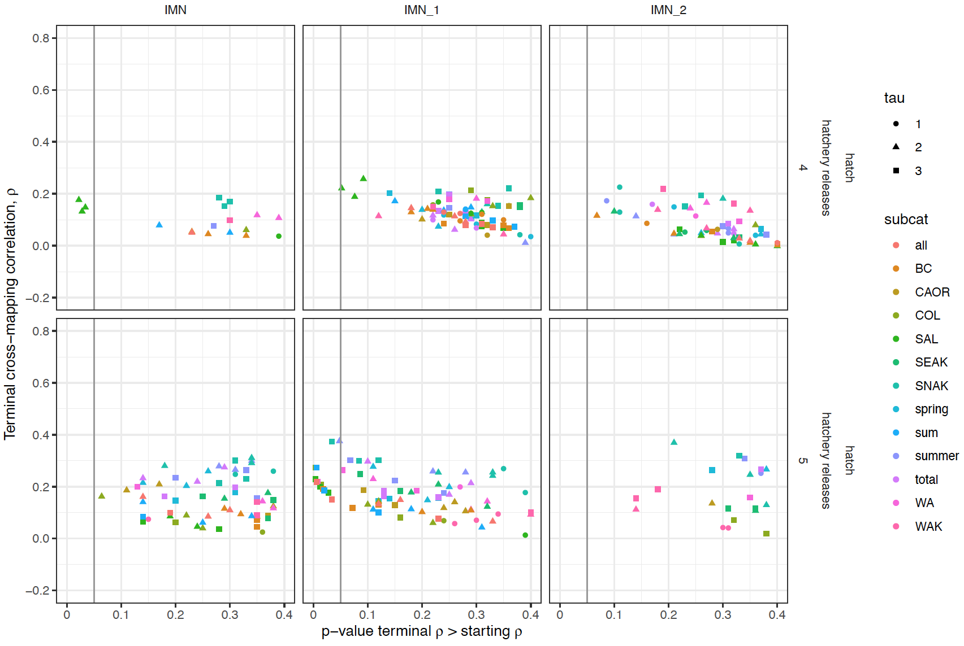

Slide 9
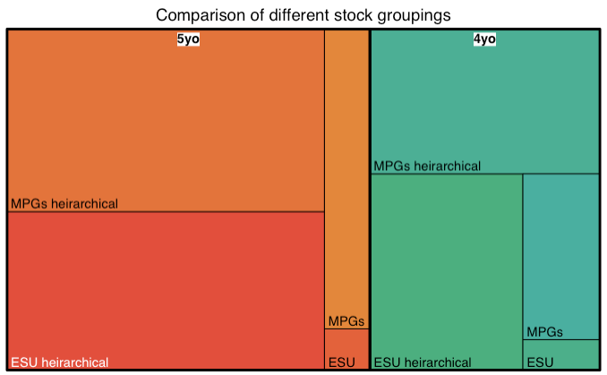
This treemap displays our hierarchical CCM results as a set of nested rectangles. Each group (and subgroup) is represented by a rectangle, in which the area is proportional to the terminal rho from the CCM of all the putative causal variables whose p-value was <= 0.1 (the p-value of the test that the terminal rho is significantly higher than the minimum library rho). If multiple tau for a causal variable had a p-value <= 0.1, only the tau with the highest rho was retained. If multiple offsets of a causal variable were significant, only the offset with the highest rho was retained.
The first grouping is for 5 year old (orange) vs 4 year old (green) recruits per spawner. The data for the 5 year old recruits had more significant causal variables.
Within each recruit age, we can compare the different ways the data are grouped.
‘ESU’ is for a CCM in which all the stocks are combined in the same attractor,
‘MPGs’ divides the stocks by the three main MPGs, Middle Fork Salmon, Imnaha, and Upper Salmon and excludes the South Fork Salmon and Lower Snake.
For both 4yo and 5yo recruits, the ESU level revealed the least causality, although it also has the smallest sample size whereas the MPGs have 3X as many CCM analyses, but even if you increase the size of the ESU box x3, more variables are causal at the MPG level.
This may be because there are different driving forces between the stocks and they don’t belong on the same attractor so there is little pattern in the attractor for all stocks combined. Alternatively, each stock may be on a different part of the same attractor but the sampling is insufficient or the stochasticity is so high that it can’t be resolved.
The stocks were also divided based on the simplex hierarchical analysis. The ‘ESU hierarchical’ arrangement is based on the hierarchical analysis of the whole ESU for 4yo and 5yo recruit per spawner data separately (slide 1). The ‘MPG hierarchical’ arrangement is based on the separate hierarchical analyses of each MPG (slides 3, 5, 7).
Although these are the biggest boxes, they also have more analyses. ‘MPG hierarchical’ has 6-7x as many analyses and ‘ESU hierarchical’ has 5x as many analyses than the whole ESU level. MPG hierarchical has 6-7x as many analyses

Slide 10
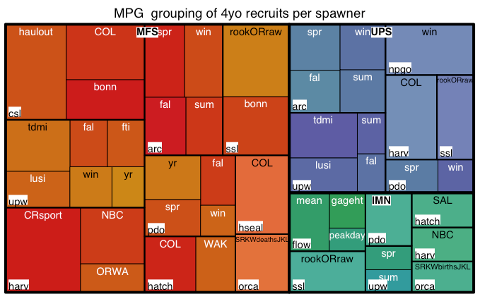
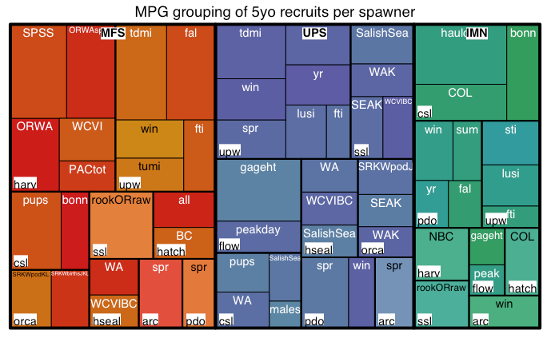
MPGs with the most significant causal relationships within the ESU

Slide 11
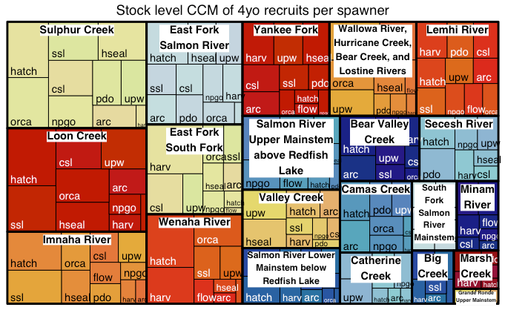
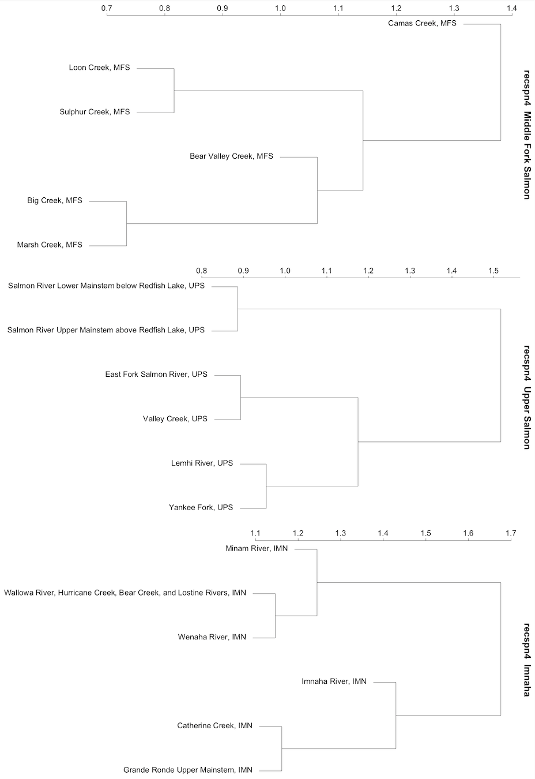
CCM at the stock level – recspn4

Slide 12
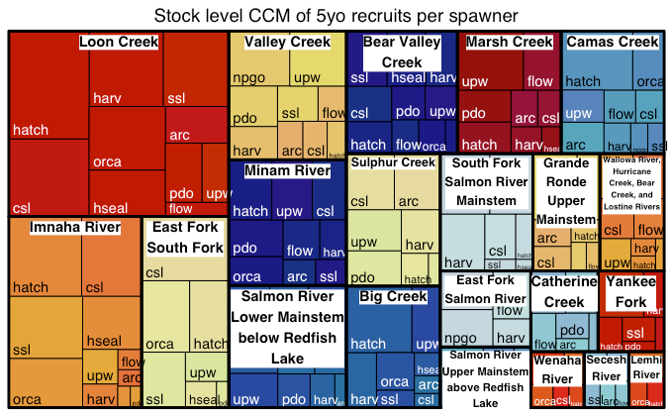
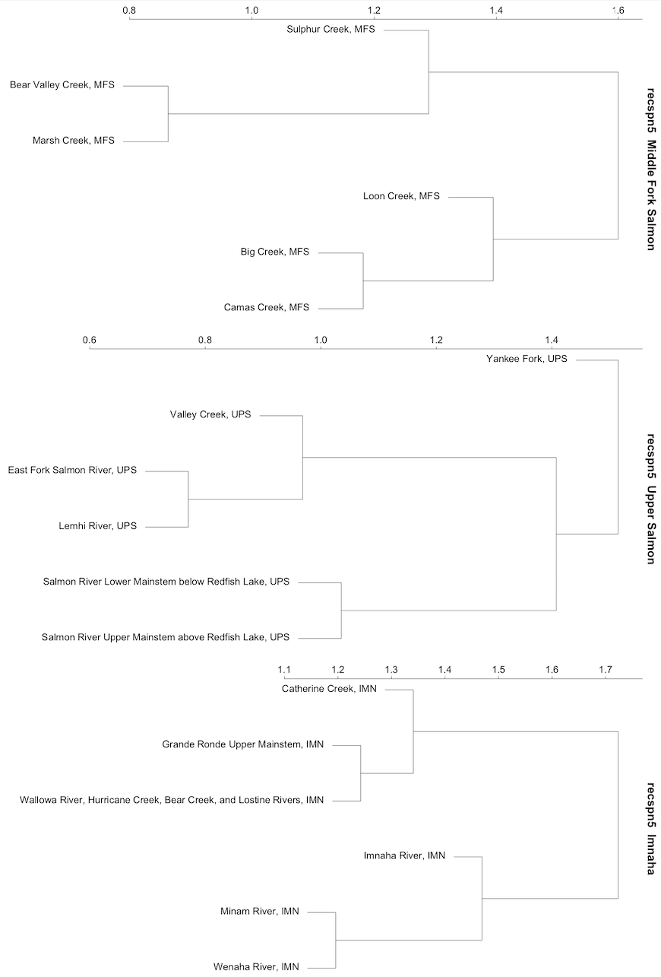
CCM at the stock level – recspn5

Slide 13
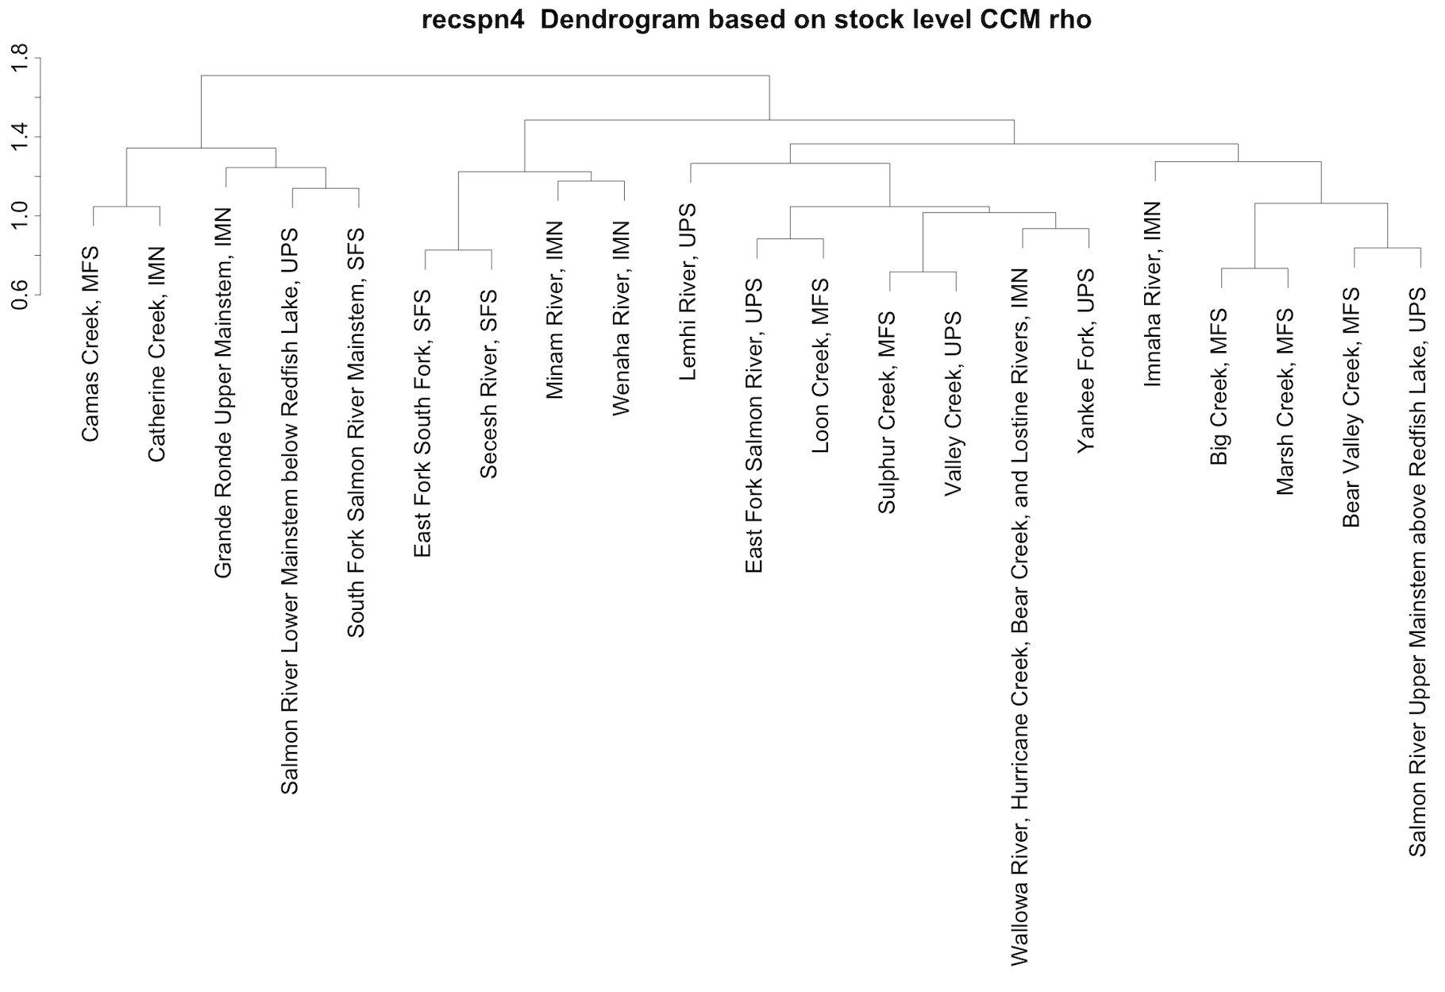
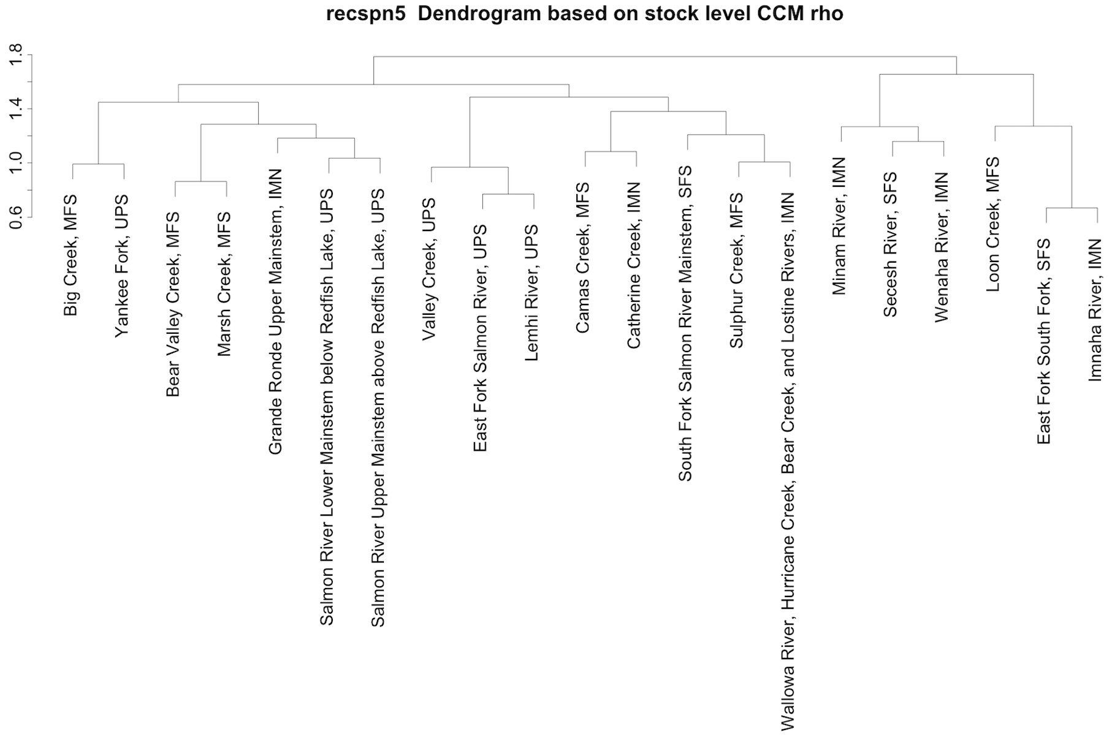
Cluster stocks based on stock level CCM rho
D_1
D_1
D_2
D_2
D_3
D_3
D_4
D_4

